Slide 1
This week discussion:
Select one product of your choice (e.g., a computer, video camera, watch, jacket, purse, car, etc.).
Search on the Internet for at least 10 different vendors (you can find several vendors on eBay, Amazon, etc.).
Collect the product price per vendor and prepare a table in Excel, include the names of the vendors, website, price of the product and shipping cost (if applicable).
Include descriptive statistics of your data set: mean, SD, median, maximum, minimum, range.
IMPORTANT: Insert your table as a JPG image.
Make sure your table has a professional look.
Finally, answer the following questions:
1. Did you find any challenge on your data collection procedure?
2. Was your data collection random? Explain how did you select the 10 vendors.
3. Based on the data collected and statistical analysis, what can you tell us about the distribution in prices? Apply critical thinking.

Slide 2
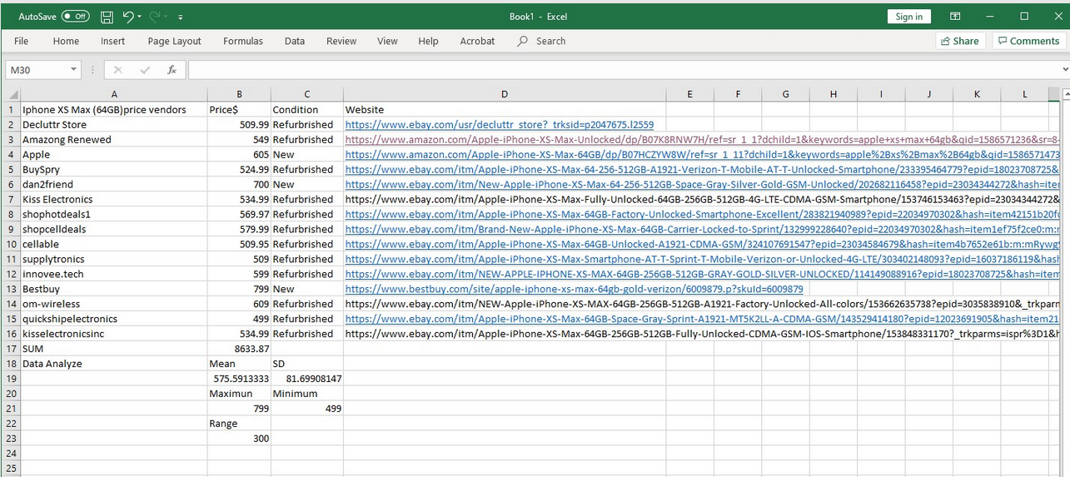
No!

Slide 3
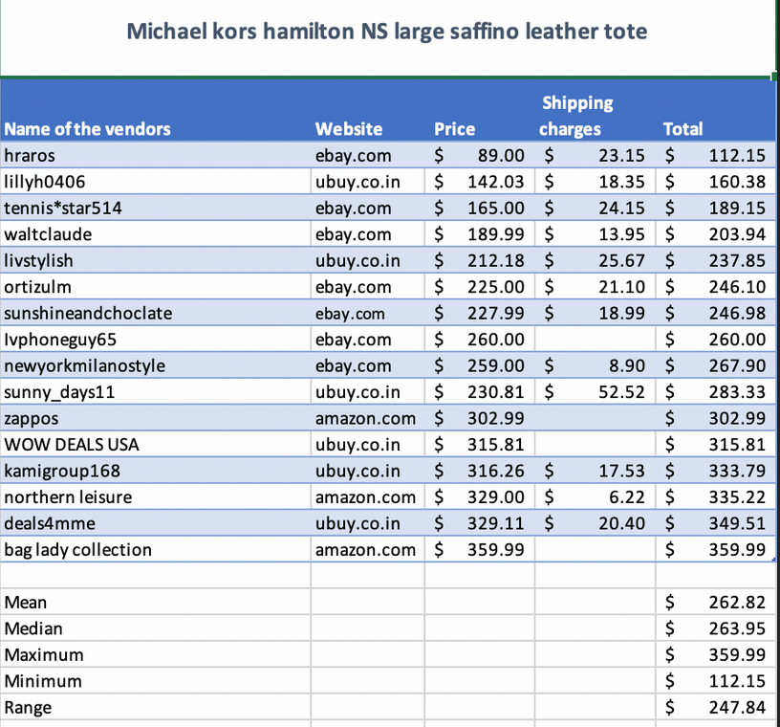
Good example

Slide 4
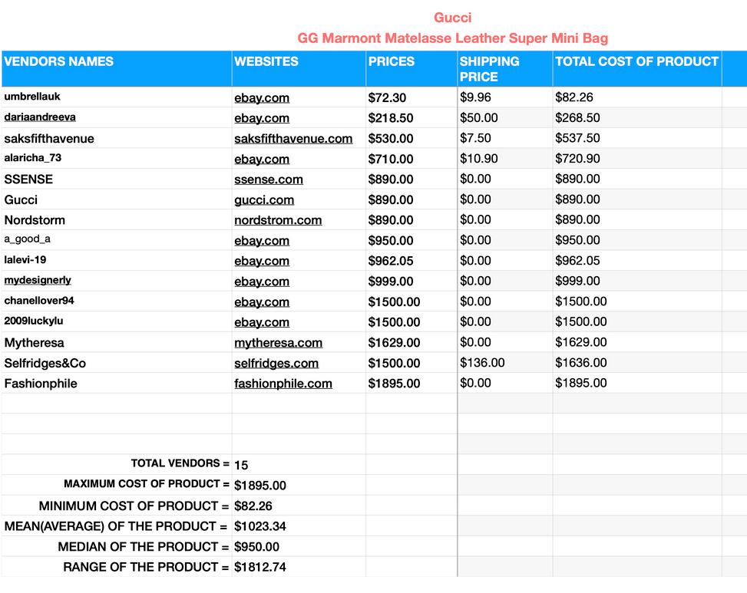
Good example.
Website good presented (not long link).
Still, table can use a better format presentation.

Slide 5
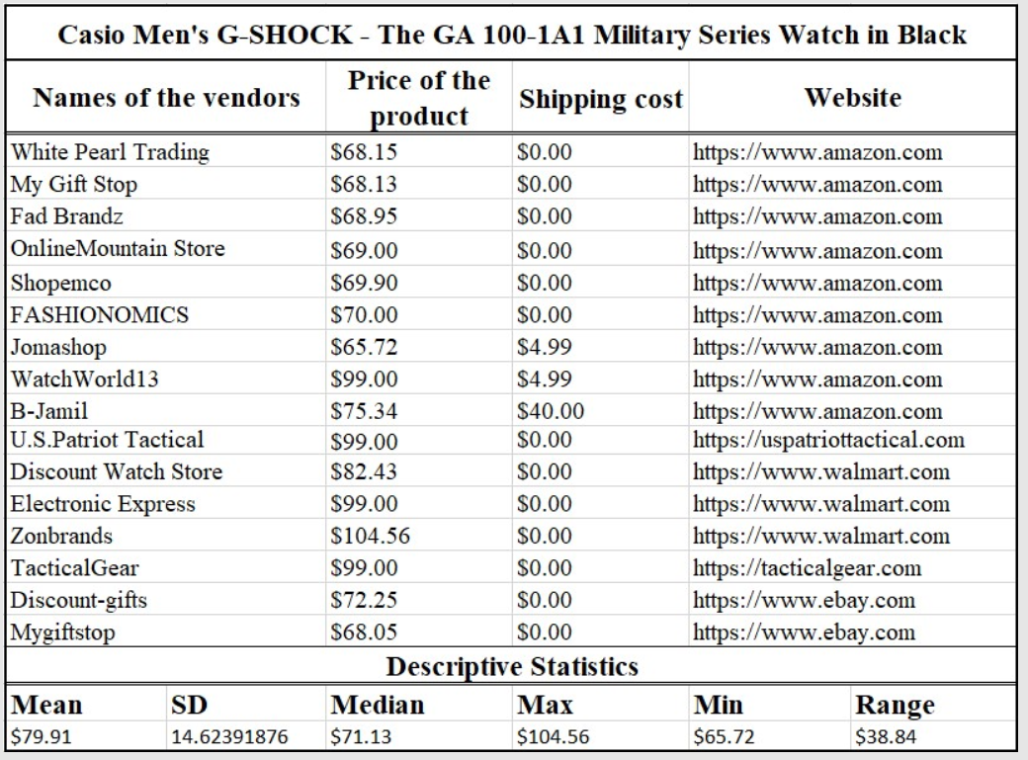
Another good example:
Well organized.
Product name on top.
Same number of decimals.
Short web site address

Slide 6
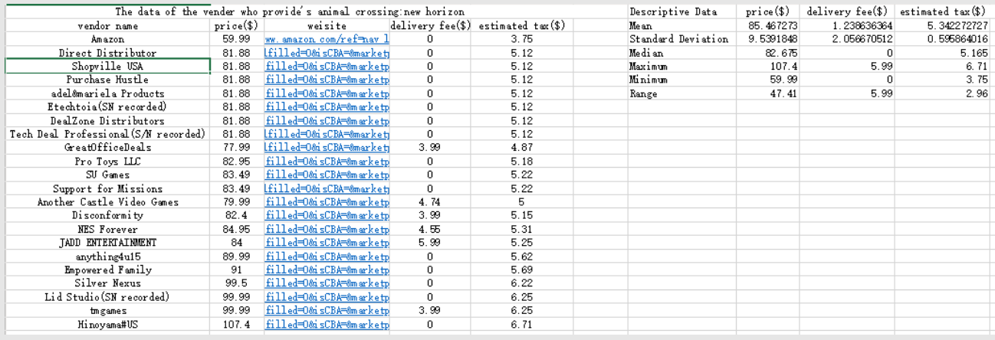
This table is good since it includes delivery fee and taxes.
I can use a more professional format presentation.
Do not just capture your excel table, prepare it for presentation.

